Slide 1
Executive Function and Intelligent Goal-directed Behavior: Perspectives from Psychology, Neurology, and Computer Science
Graham Pluck, Antonio Cerone, and David Villagomez-Pacheco
4th International Workshop on Cognition: Interdisciplinary Foundations, Models and Applications
27 September 2022, Berlin

Slide 2
Graham
Pluck
Antonio
Cerone
David
Villagomez-Pacheco
‘Executive functions are high-level cognitive processes, often associated with the frontal lobes, that control lower-level processes in the service of goal-directed behavior’
Miyake, A., et al.: The unity and diversity of executive functions and their contributions to complex "Frontal Lobe" tasks: a latent variable analysis. Cogn. Psychol. 41, 49-100 (2000)

Slide 3
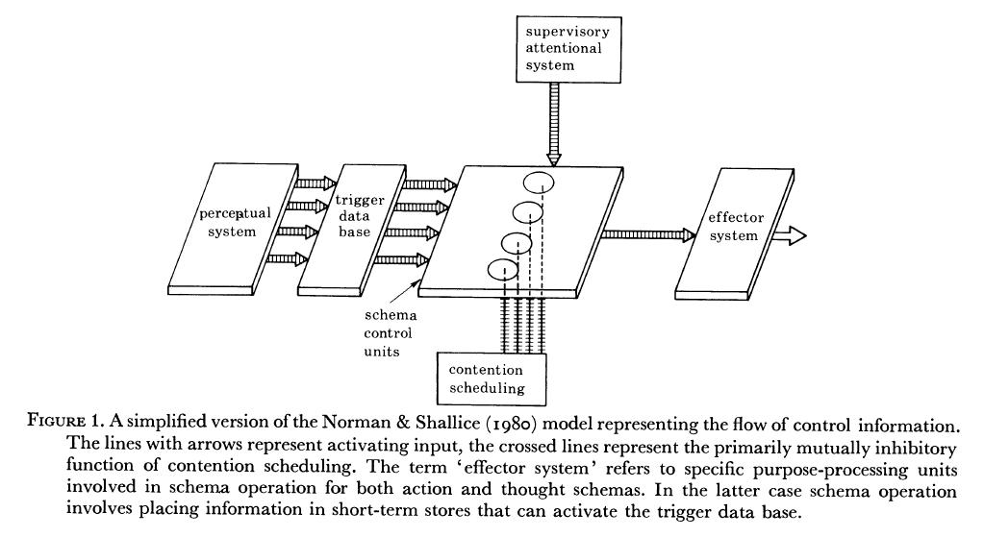
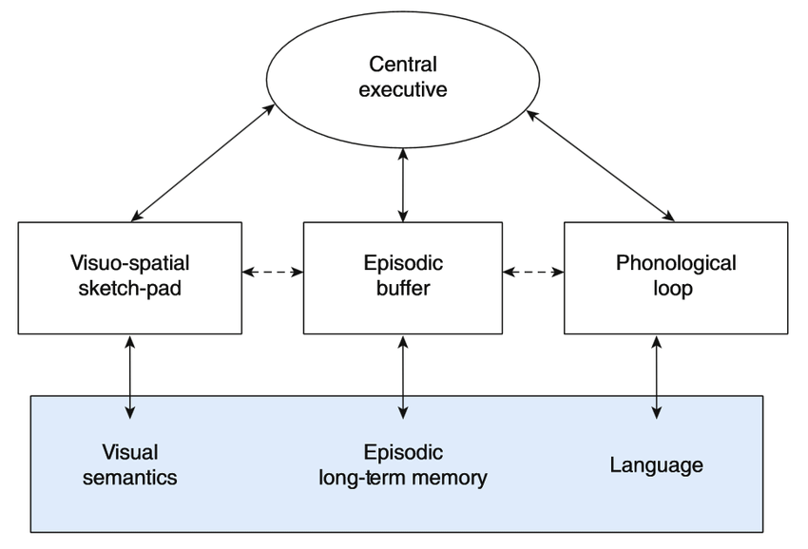
Norman, D.A., Shallice, T.: Attention to action: willed and automatic control of behavior. Human Information Processing Technical Report no. 99 (1980).

Slide 4
The concept of ‘executive function’ originated in computer science. Programs that control other programs.
In 1956 a program called the Automatic Supervisor was developed for the IBM 702.
Shortly afterwards, General Motors Executive System was developed for the IBM 704
Moncreiff, B.: An automatic supervisor for the IBM 702. AIEE-IRE '56 Joint ACM-AIEE-IRE Western Computer Conference, pp. 21-25 (1956)

Slide 5
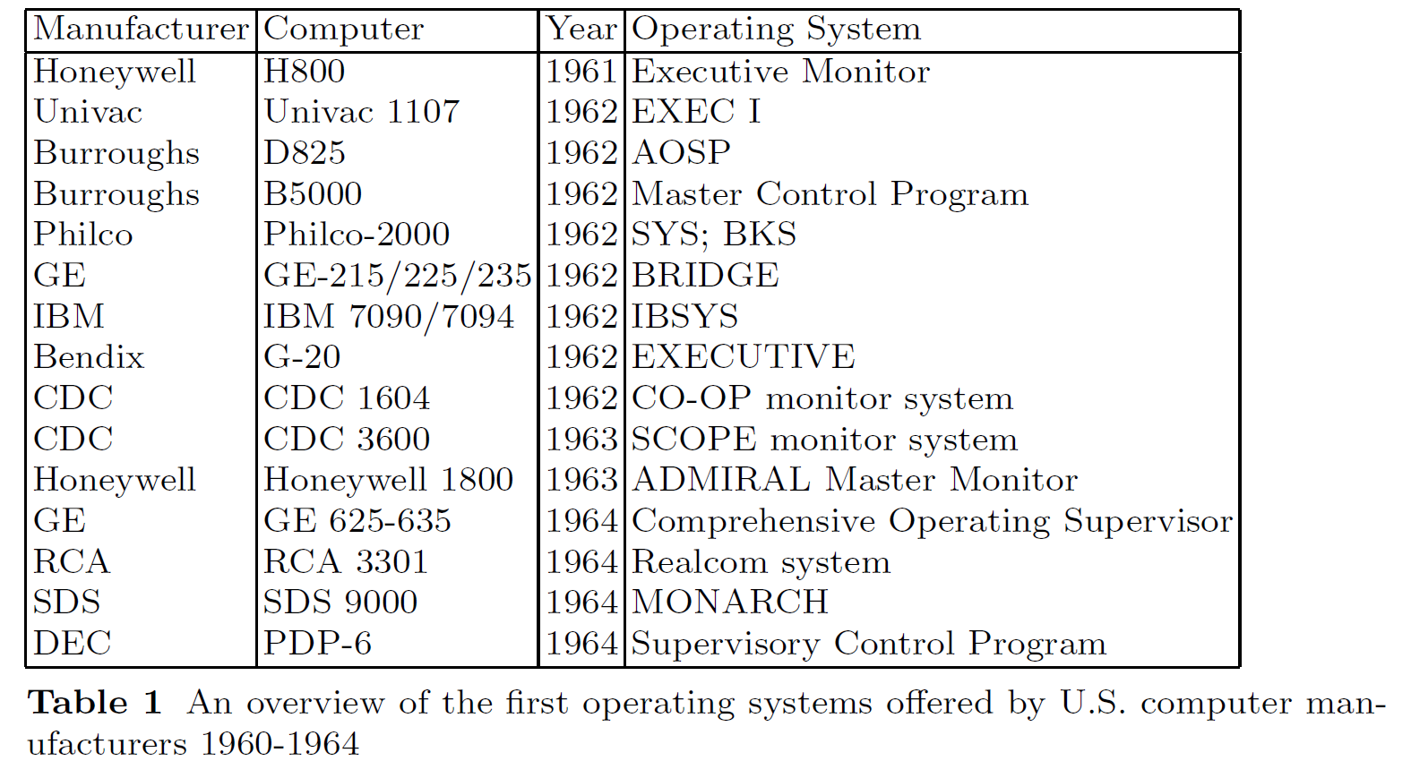
Several other top-down controllers, or operating systems were developed with similar ‘executive’ names.
This approach in computer science coincided with the development of cognitive science, starting in 1956.
Bullynck, M.: What is an operating system? a historical investigation (1954–1964). In: De Mol, L., Primiero, G. (eds.) Reflections on Programming Systems: Historical and Philosophical Aspects. Springer, Cham (2018).

Slide 6
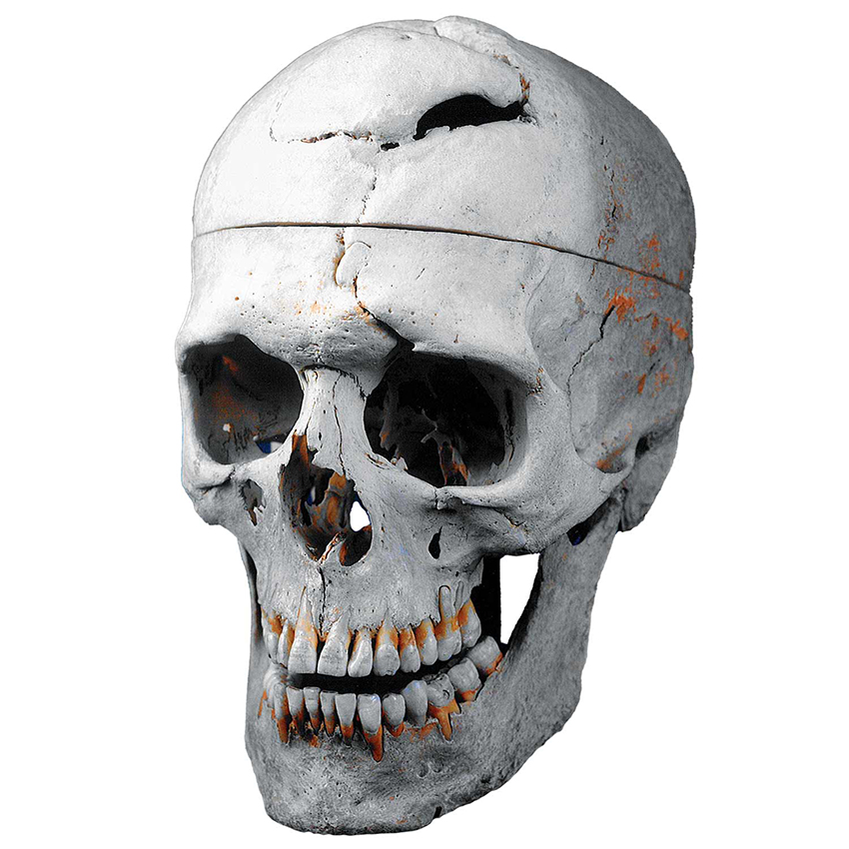
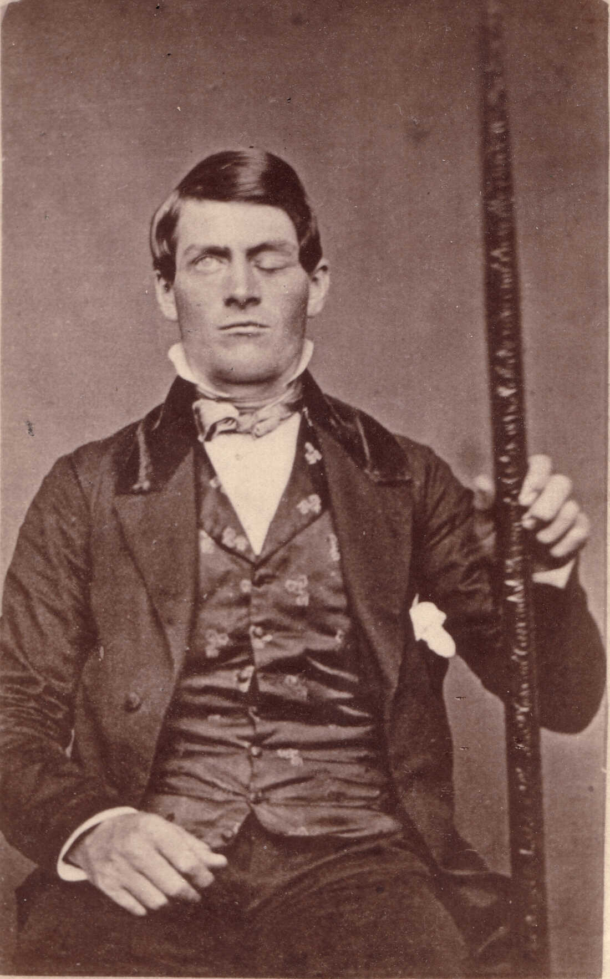
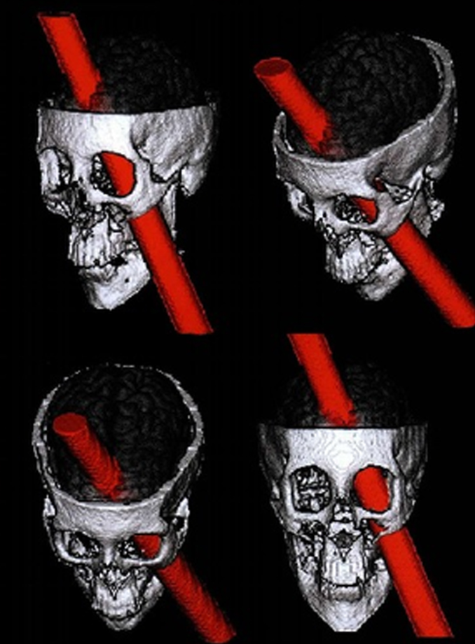
Phineas Gage, after surviving a frontal lobe injury, became erratic, with difficulties in planning, decision making, and disinhibition.
This pattern of symptoms is now known in neurology as the dysexecutive syndrome.
Many similar cases have been reported of people with frontal lobe damage who become disorganized in the lives. Many maintain > average IQ.
Harlow, J.M.: Recovery from the passage of an iron bar through the head. Hist. Psychiatry 4, 274-281 (1993)

Slide 7
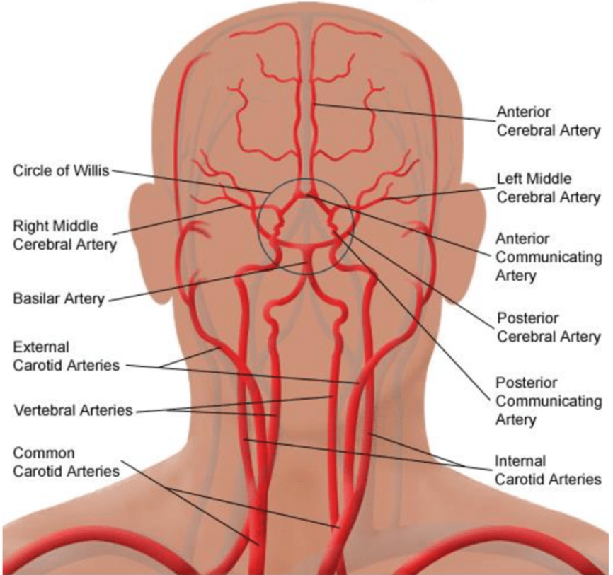
Executive control is effortful and resource demanding
Embodied explanations argue for glucose consumption.
Similar, neurophysiological explanations concern oxygen consumption.
Antagonistic activity of different brain networks is a strong alternative explanation.

Slide 8
Some commonly used tests of executive function
“flat”
“felt”
Saying words that begin with a letter (phonemic fluency test)
Sorting card cards into categories and adapting when the sort rule changes (Wisconsin Card Sort Test)
Estimating the number of camels in the Netherlands (Cognitive Estimation Test)
Alternating between two task requirements (Trail Making Test)
Completing sentences with a final word that makes no sense (Hayling Test)
Repeating a string of numbers in reverse order (Digit Span test)
Planning moves to achieve an end goal state (Towers of Hanoi)
Naming the color of ink that color-name words are written in, e.g., RED (Stroop Task)
“family”
“fan”

Slide 9
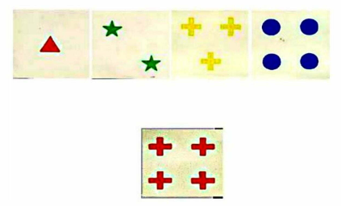
Some commonly used methods of measuring of executive function
Saying words that begin with a letter (phonemic fluency test)
Sorting card cards into categories and adapting when the sort rule changes (Wisconsin Card Sort Test)
Estimating the number of camels in the Netherlands (Cognitive Estimation Test)
Alternating between two task requirements (Trail Making Test)
Completing sentences with a final word that makes no sense (Hayling Test)
Repeating a string of numbers in reverse order (Digit Span test)
Planning moves to achieve an end goal state (Towers of Hanoi)
Naming the color of ink that color-name words are written in, e.g., RED (Stroop Task)

Slide 10
Some commonly used methods of measuring of executive function
Saying words that begin with a letter (phonemic fluency test)
Sorting card cards into categories and adapting when the sort rule changes (Wisconsin Card Sort Test)
Estimating the number of camels in the Netherlands (Cognitive Estimation Test)
Alternating between two task requirements (Trail Making Test)
Completing sentences with a final word that makes no sense (Hayling Test)
Repeating a string of numbers in reverse order (Digit Span test)
Planning moves to achieve an end goal state (Towers of Hanoi)
Naming the color of ink that color-name words are written in, e.g., RED (Stroop Task)

Slide 11
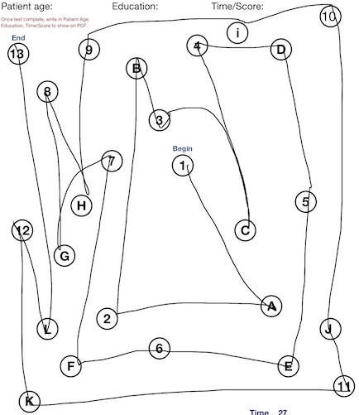
Some commonly used methods of measuring of executive function
Saying words that begin with a letter (phonemic fluency test)
Sorting card cards into categories and adapting when the sort rule changes (Wisconsin Card Sort Test)
Estimating the number of camels in the Netherlands (Cognitive Estimation Test)
Alternating between two task requirements (Trail Making Test)
Completing sentences with a final word that makes no sense (Hayling Test)
Repeating a string of numbers in reverse order (Digit Span test)
Planning moves to achieve an end goal state (Towers of Hanoi)
Naming the color of ink that color-name words are written in, e.g., RED (Stroop Task)

Slide 12
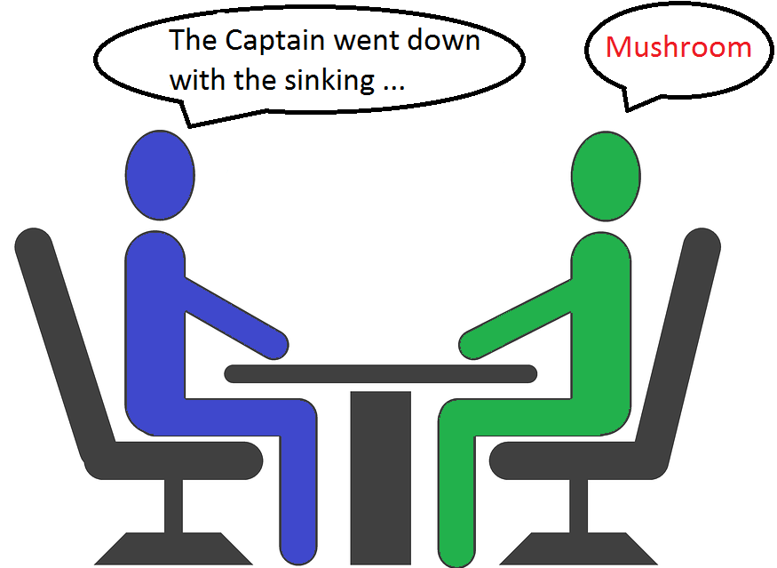
Some commonly used methods of measuring of executive function
Saying words that begin with a letter (phonemic fluency test)
Sorting card cards into categories and adapting when the sort rule changes (Wisconsin Card Sort Test)
Estimating the number of camels in the Netherlands (Cognitive Estimation Test)
Alternating between two task requirements (Trail Making Test)
Completing sentences with a final word that makes no sense (Hayling Test)
Repeating a string of numbers in reverse order (Digit Span test)
Planning moves to achieve an end goal state (Towers of Hanoi)
Naming the color of ink that color-name words are written in, e.g., RED (Stroop Task)

Slide 13
Some commonly used tests of executive function
Saying words that begin with a letter (phonemic fluency test)
Sorting card cards into categories and adapting when the sort rule changes (Wisconsin Card Sort Test)
Estimating the number of camels in the Netherlands (Cognitive Estimation Test)
Alternating between two task requirements (Trail Making Test)
Completing sentences with a final word that makes no sense (Hayling Test)
Repeating a string of numbers in reverse order (Digit Span test)
Planning moves to achieve an end goal state (Towers of Hanoi)
Naming the color of ink that color-name words are written in, e.g., RED (Stroop Task)
“3 – 5- 2”
“2 – 5- 3”

Slide 14
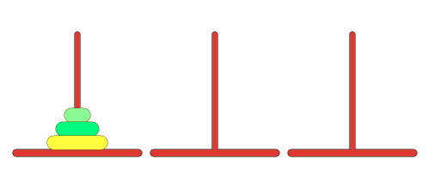
Some commonly used methods of measuring of executive function
Saying words that begin with a letter (phonemic fluency test)
Sorting card cards into categories and adapting when the sort rule changes (Wisconsin Card Sort Test)
Estimating the number of camels in the Netherlands (Cognitive Estimation Test)
Alternating between two task requirements (Trail Making Test)
Completing sentences with a final word that makes no sense (Hayling Test)
Repeating a string of numbers in reverse order (Digit Span test)
Planning moves to achieve an end goal state (Towers of Hanoi)
Naming the color of ink that color-name words are written in, e.g., RED (Stroop Task)

Slide 15
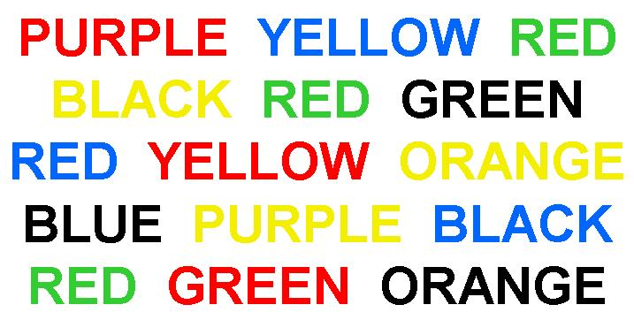
Some commonly used methods of measuring of executive function
Saying words that begin with a letter (phonemic fluency test)
Sorting card cards into categories and adapting when the sort rule changes (Wisconsin Card Sort Test)
Estimating the number of camels in the Netherlands (Cognitive Estimation Test)
Alternating between two task requirements (Trail Making Test)
Completing sentences with a final word that makes no sense (Hayling Test)
Repeating a string of numbers in reverse order (Digit Span test)
Planning moves to achieve an end goal state (Towers of Hanoi)
Naming the color of ink that color-name words are written in, e.g., RED (Stroop Task)

Slide 16
“Diversity and Unity” of Executive Functions
Response inhibition
Task switching
Updating (of working memory)
Miyake, A., et al.: The unity and diversity of executive functions and their contributions to complex "Frontal Lobe" tasks: a latent variable analysis. Cogn. Psychol. 41, 49-100 (2000)

Slide 17
There is probably no single ‘executive module’.
So, what do we actually mean by executive function?
The executive component most likely fractionates into different parts.

Slide 18
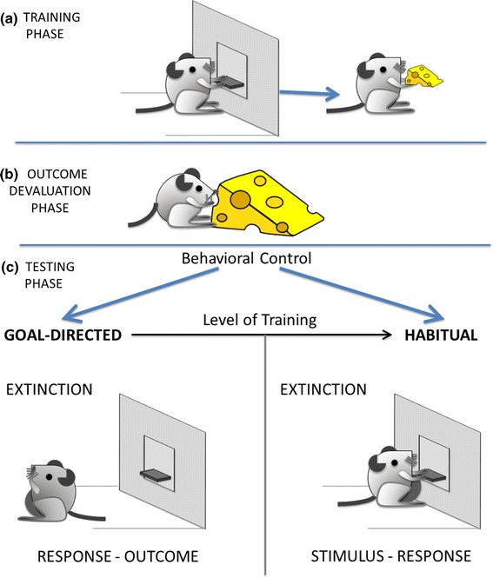
(a) A rat is trained to press a lever to obtain a reward (e.g., cheese)
(b) The cheese is devalued (e.g., by letting the rat get sated)
(c) The rat is now tested.
If it doesn’t press the level. Its previous lever-pressing behavior was goal-directed.
If it continues to press the lever, its behavior is habitual.
This distinction is equivalent to model-based and model-free in computational reinforcement learning.

Slide 19
Goal-directed behaviors
Habit-based behaviors
Norman, D.A., Shallice, T.: Attention to action: willed and automatic control of behavior. Human Information Processing Technical Report no. 99 (1980).

Slide 20
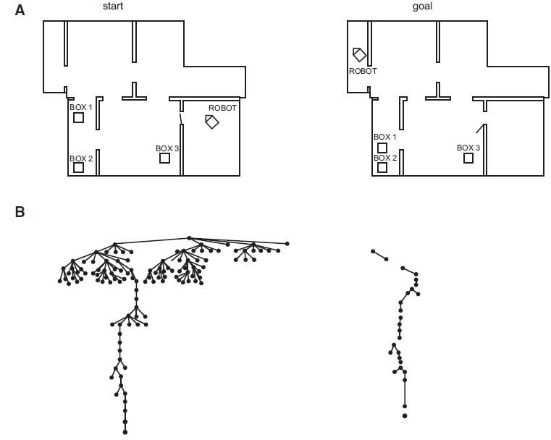
Computational-cognitive and cognitive neuroscience interpretation
Duncan has analyzed complex executive function performance as being achievable by planning and executing actions to achieve sub-goals.
In this AI example, from Sacerdoti (1974), the planned path from start state to goal state is complex and inefficient. With sub-goals identified it is efficient.
Simple goal-directed behavior can produce complex executive performance.
Without sub-goals
With sub-goals
Sacerdoti (1974). Planning in a hierarchy of abstraction spaces. Artif. Intell. 5, 115–135.
cited in Duncan, (2013). The structure of cognition: attentional episodes in mind and brain. Neuron, 80(1), 35-50.

Slide 21
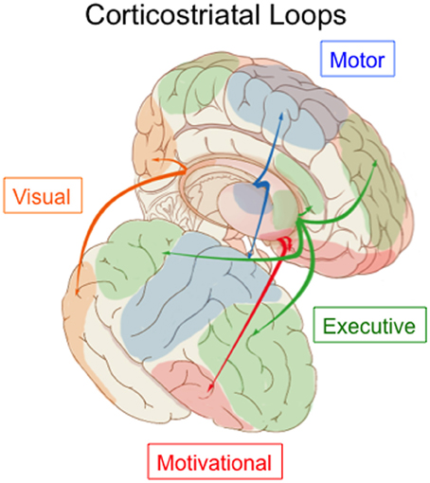
There are several cortico-subcortical loops.
Each is based on a different area of cortex.
Each projects to the striatum and thalamus and back to the cortex
The loop involving dorsolateral prefrontal and posterior parietal cortices is considered the ‘executive loop’.
A simple goal-directed action is said to require >20 passes through the loop.

Slide 22
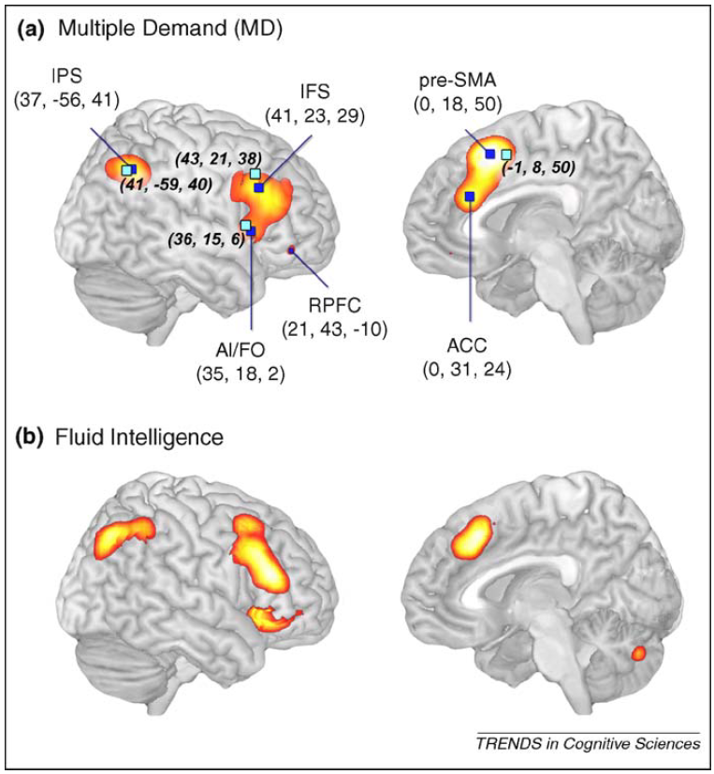
The animal anatomy-derived executive loop fits directedly onto the ‘multiple demand system’ derived from functional brain imaging.
This multiple demand system is active with any high task-load, independently of modality.
It is also invoked by traditional fluid intelligence tests.
This is proposed as the neurophysiological basis of both executive function and intelligence.
So, is the concept of executive function redundant?
Duncan, J.: The multiple-demand (MD) system of the primate brain: mental programs for intelligent behaviour. Trends Cogn. Sci. 14, 172-179 (2010)

Slide 23
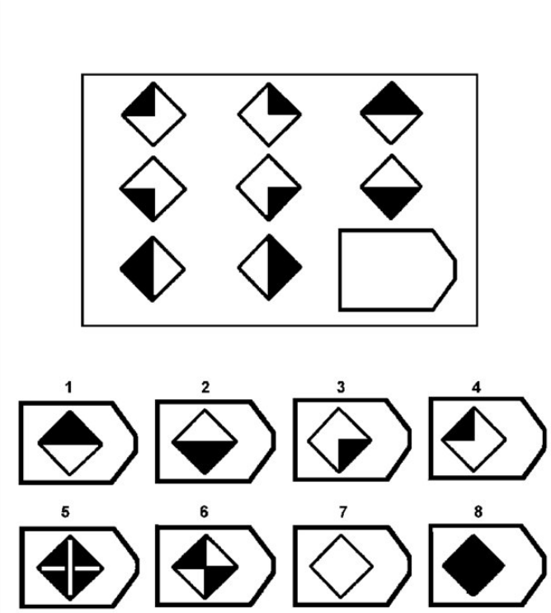
General intelligence (g) influences performance on all cognitive tasks.
A typical assessment of g is this, from the Raven’s Progressive Matrices.
There is only one acceptable correct answer.
g accounts for virtually all the variance in executive function ability.

Slide 24
Areas of the brain, that when damaged, cause a drop in task performance. The Green shows overlap of areas associated with both drop in g and drop in executive function.
Barbey, et al., (2012). An integrative architecture for general intelligence and executive function revealed by lesion mapping.
Brain, 135(4), 1154-1164.

Slide 25
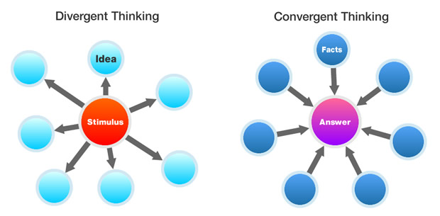
Guilford, J.P.: The Nature of Human Intelligence. McGraw-Hill, New York (1967)
Convergent vs divergent thinking was made popular by the psychologist J.P. Guilford.
He was also the first psychologist to use the expression ‘executive function’.
Divergent thinking tasks do not correlate with intelligence.
Divergent cognitive tasks involve greater involvement of the frontal-lobes and recruit other executive-related brain networks.
Focusing on divergent executive functions may allow the identification of executive control that involves more than fluid intelligence.

Slide 26
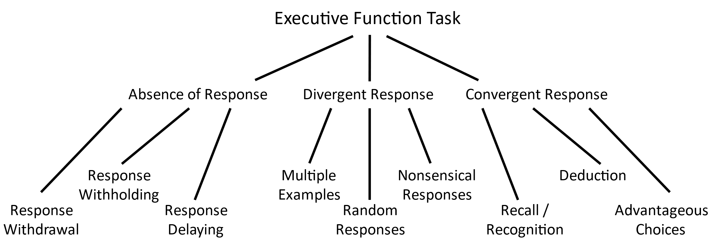
A proposed taxonomy of executive functions based on the stated goals of the task
Most current executive function / IQ tests

Slide 27
Divergent Responses / Absence Responses
I have found that the Hayling Test (a divergent task) is a better predictor of GPA than ‘intelligence’ or working memory.
It also predicts performance of car salesmen, better than ‘intelligence’.
For both GPA and sales, motor response withholding was also strong predictor of achievement.
Perhaps, real-life intelligent goal-directed behavior is (partially) dependent on divergent cognition, and cognitive-motor integration (embodied cognition)?
Pluck, G. et al.: Separate contributions of general intelligence and right prefrontal neurocognitive functions to academic achievement at university level. Trends Neurosci. Educ. 5, 178-185 (2016)
Pluck, G. et al: Response suppression, strategy application, and working memory in the prediction of academic performance and classroom misbehavior: A neuropsychological approach. Trends Neurosci. Educ. 17, 100121 (2019)
Pluck, G., et al.: Executive functions and intelligent goal-directed behavior: A neuropsychological approach to understanding success using professional sales as a real-life measure. Psychol. Neurosci. (2020)

Slide 28
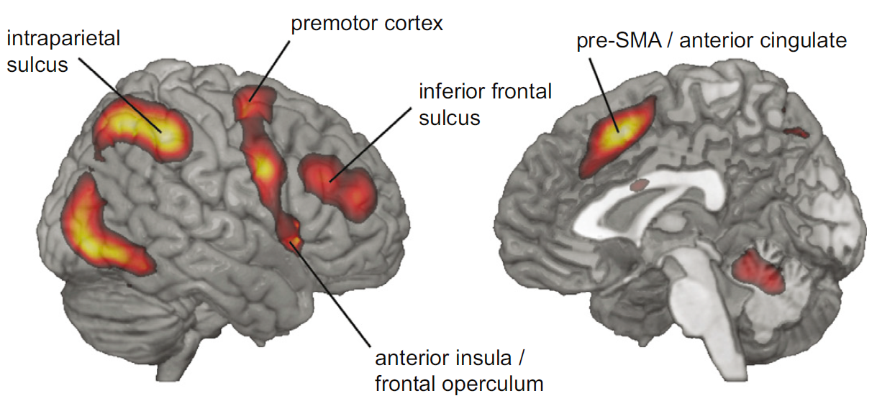
fMRI data showing the cortical areas that show increased activity with cognitive load:
the ‘multiple demand system’
Cerebellum
Areas very frequently associated with cognitive processing
Areas very frequently associated motor control
Area associated with Interoception / homeostasis
Fedorenko, et al.: Broad domain generality in focal regions of frontal and parietal cortex. Proc. Natl. Acad. Sci. U. S. A. 110, 16616-16621 (2013)

Slide 29
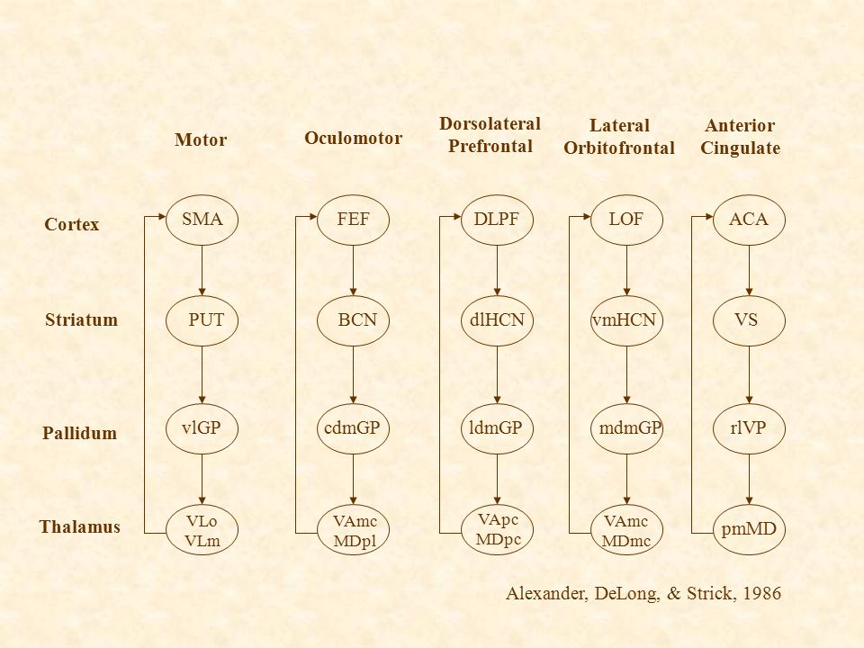
The ‘executive circuit’
Additional subcortical aspect of the multiple demand system
This probably occurs because goal-directed action, when repeated, will become habit, aka procedural memory. It thus has to involve the motor circuit.
Camilleri, et al: (2018). Definition and characterization of an extended multiple-demand network. NeuroImage, 165,138-147.

Slide 30
Executive function, as a cognitive skill, drives intelligent goal-directed behavior.
But it is conceptually confused with intelligence (a psychometric construct).
The analysis of motor response withholding/withdrawing/slowing and with divergent executive task performance may allow the disambiguation of intelligence from executive function.

Slide 31
@plucklab
Pluck Lab
@DrGPluck

